Slide 1

VOICE ASSISTANT (EMOTION DETECTION) USING PYTHON
Team Members:
MANASVI S 2022BCSE07AED957
DORESWAMY S B 2022BCSE07AED956
NITYA 2022BCSE07AED958
POORNIMA 2022BCSE07AED953
DARSHAN 2022BCSE07AED954
Name of the Guide: Dr SRIDHAR DEVARAJAN,
Project Review-SEE

Slide 2

Agenda
Problem Statement (Brief description as points)
Introduction
Review of literature (Refer minimum of 5, recent journal papers)
Observations from literature review (Brief description as points)
Limitations of literature review (Brief description as points)
Objectives (Brief description as points)
Requirements (Hardware and Software)
System Architecture
Module Descriptions (Algorithm, source code and screen shots)
Performance Evalution (with metrics and graphs)
Conclusion
Advantages of the project
Limitations of the project
Applications of the project
Future Enhancements
Publication status
References ( Min. of 12 papers)

Slide 3
Problem Statement
Traditional voice assistants lack the ability to understand and respond empathetically to a user’s emotional state.
Emotional context i communication is critical for applications like mental health support and customer service.
Audio Processing Module:
Extracts features such as pitch, loudness, and tempo from user speech for emotion detection.
Text-to-Speech Response Module:
Generates contextually appropriate and empathetic responses.
Emotion Recognition Module:
Classifies emotions using pre-trained models or rule-based approaches.
Potential applications in mental health support, education, and customer service.
Enhanced user experience with personalized, empathetic responses.

Slide 4
Introduction
"Imagine a world where technology not only hears you but truly understands how you feel."Our voice carries emotions, revealing much more than just words.
In this project, we harness Python's power to create a voice assistant capable of detecting human emotions.
By combining speech analysis and machine learning, it bridges the gap between human interaction and artificial intelligence.
This innovation can revolutionize fields like mental health, customer service, and personal productivity.
Let’s explore how this emotion-aware assistant works and its potential to redefine human-machine communication.

Slide 5
Review of literature
The review discusses the advancements in digital assistants, particularly focusing on emotion detection through speech. Since the first chatbot in 1960, significant progress has been made in speech recognition and emotion AI. Techniques like Bayesian networks, GMM, HMM, and deep learning models (RNNs and CNNs) are used to interpret emotions from speech, enhancing applications in healthcare, customer service, and human-computer interactions. Digital assistants such as Alexa and Siri are increasingly incorporating Emotion AI, allowing them to understand and respond to human emotions by analyzing acoustic features like pitch, tone, and rhythm.
While these technologies have made great strides, challenges remain, such as the variability in emotional expression across different languages and cultures. Deep learning models have improved emotion detection accuracy by capturing the dynamic nature of emotional speech. However, real-time implementation is still a challenge due to high computational demands and the need formore robust systems that work in diverse environments. Future research aims to improve these models, incorporate multimodal data, and enhance real-time performance for broader application in real-world scenarios.

Slide 6
Observations from the literature review
Historical Progress
Emotion AI Integration
Techniques in Emotion Detection
Acoustic Feature Analysis
Application Areas
Cultural and Linguistic Variability
Speech Signal Processing
Advancements in Deep Learning
Real-time Challenges
Multimodal Data
Real-World Applications
Improvement in User Interaction
Deep Learning for Sensitivity Classification

Slide 7
Limitations of the literature review
Cultural and Linguistic Variability
Real-time Processing Challenges
Data Dependency
Accuracy in Complex Emotions
Limited Emotional Range
Environmental Variability
Cognitive and Contextual Factors
Lack of Multimodal Integration
Ethical Concerns
Technological Limitations in Speech Quality
Generalization Across Devices
Lack of Standardized Frameworks
Scalability Issues
Limitations in Expressing Complex Emotions

Slide 8
Objectives
Emotion Detection:
Develop a voice assistant capable of identifying human emotions such as happiness, sadness, anger, and neutrality from audio inputs.
Empathetic Response:
Enable the assistant to respond empathetically by generating contextually appropriate outputs using text-to-speech technologies.
Real-Time Interaction:
Design the system to process audio inputs in real time, ensuring quick and relevant responses.
Accuracy and Adaptability:
Improve the accuracy of emotion detection using machine learning algorithms and pre-trained models.
Ease of Integration:
Build the system to integrate with other applications or devices, such as IoT systems, for wider usability.
User Accessibility:
Enhance the accessibility of the assistant for a broad range of users, including those with unique emotional expression patterns.

Slide 9
Requirements
Hardware:
User Device:
Mobile phones, desktop computers, or IoT devices
Database and Storage Servers:
Processor
RAM
Storage
Software:
Operating System
Programming Languages
Python
Speech Recognition Software
Emotion Recognition Libraries
Text-to-Speech (TTS)

Slide 10
System Architecture
High-Level Components:
Frontend Interface
Voice Input Interface
Response Output Interface
2. Works on the Ground
Emotional Introduction Services
3. Data storage and processing
User data storage
Storage and maintenance
4. The infrastructure component
The API Gateway
Load Balance
5. Business process model
User Interaction
Sentiment recognition and ASR

Slide 11
List of Modules
Rule Based Emotion Detection
And
Model-Based Emotion Detection

Slide 12
Module-I
Algorithm
Initialize the System:
Load Pre-Trained RNN Model:.
Emotion Detection Using RMS Energy:
Emotion Detection Using Speech-to-Text:
Emotion Detection Using MFCC and RNN:
Generate Emotion-Based Response
Simulate Interaction
Optional Data Loading.
Loop Interaction
End Program

Slide 13
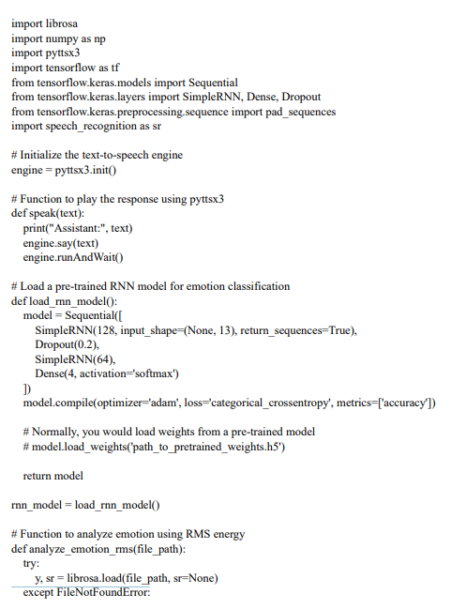
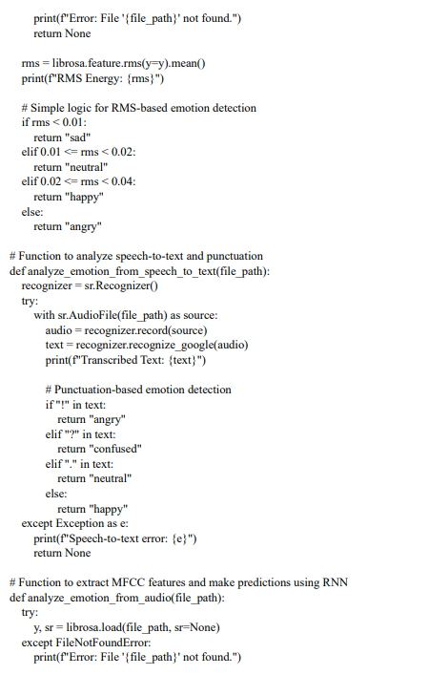
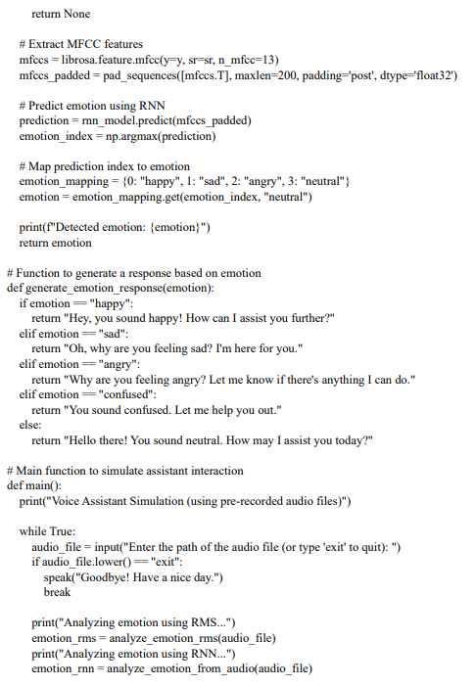
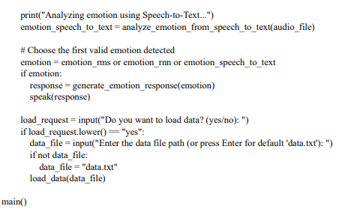
Module-I
Source Code:

Slide 14
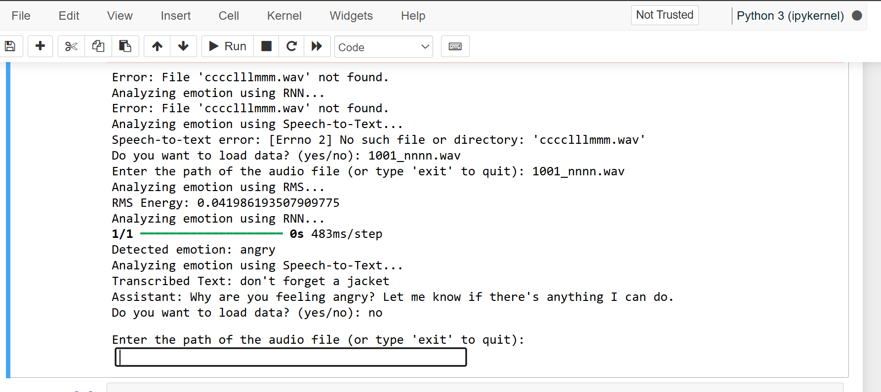
Module-I
Screen shot/Output:

Slide 15
Performance Evaluation
Emotion Classification Accuracy:
Accuracy=(Total Predictions/Correct Predictions)--​×100
Confusion Matrix:
Generate a confusion matrix to understand misclassification patterns between different emotions.
RMS Energy Threshold Performance:
Evaluate the correctness of emotion classification based on RMS energy thresholds by comparing with ground truth labels.
Speech-to-Text Error Rate:
Measure the performance of speech recognition in accurately transcribing the audio.
Use Word Error Rate (WER):
WER=Substitutions+Deletions+InsertionsTotal
Words in Reference\text{WER} = \frac{\text{Substitutions} + \text{Deletions} + \text{Insertions}}{\text{Total Words in Reference}}
WER=Total Words in ReferenceSubstitutions+Deletions+Insertions​
Real-Time Processing Speed:
Measure the time taken for each module (RMS, RNN, speech-to-text) to analyze audio files.
Ensure the system meets real-time requirements.

Slide 16
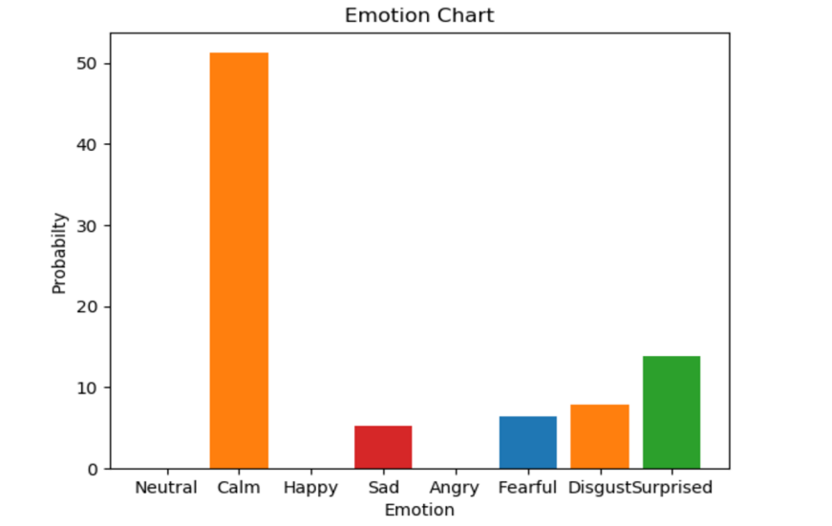
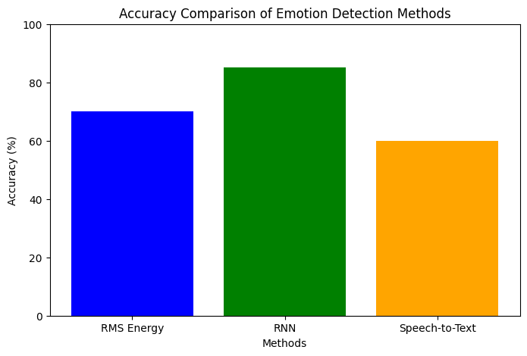
Performance Evaluation

Slide 17
Conclusion
The development of a voice assistant capable of understanding human emotions using Python is a significant step toward enhancing human-computer interaction. By integrating speech emotion recognition, this system can deliver empathetic and contextually appropriate responses, making it highly effective in fields like mental health, education, and customer service. Utilizing machine learning and audio processing techniques, it bridges the gap between emotional intelligence and technology. Real-time emotion detection ensures seamless and interactive experiences for users. Moreover, the flexibility to adapt to various accents and environments enhances its usability across diverse demographics. With further advancements, such as multilingual support and integration with wearable devices, its potential applications are vast. Privacy and security considerations remain crucial to ensure user trust

Slide 18
Advantages of the Project
Enhanced Interaction
Emotion Awareness
Real-Time Response
Improved Engagement
Personalized Feedback
Mental Health Support
Adaptive Learning
Noise Resilience
Multilingual Support
User Accessibility

Slide 19
Limitations of the Project
Limited Emotion Scope
Accent Variability Challenges
Noise Sensitivity Issues
Real-Time Processing Delay
Privacy Concerns
Cultural Bias Risks
Limited Multilingual Support
High Resource Requirements
Ambiguous Emotion Detection
Dependence on Training Data

Slide 20
Applications of the Project
Mental Health Support
Customer Service
Education Tools
Smart Homes
Healthcare Assistance
Gaming Interaction
Entertainment
Elderly Care
Marketing Analysis
Personalized Learning

Slide 21
Future Enhancements
Multilingual Emotion Detection:
Expand emotion recognition to support multiple languages and regional accents.
Advanced Emotion Categories:
Include more complex emotions like fear, surprise, disgust, or mixed emotional states.
Real-Time Context Awareness:
Integrate contextual understanding to enhance the relevance of responses based on the user’s situation.
Personalization:
Customize the assistant's behavior and tone based on the user's emotional patterns and preferences.
Sentiment Analysis for Text:
Add the ability to detect emotions in text inputs (e.g., chats or emails) alongside audio.
Emotion-Based Recommendations:
Suggest music, videos, or activities tailored to the user’s emotional state.
AI-Powered Therapy Support:
Incorporate therapeutic dialogues for users facing stress, anxiety, or other emotional challenges.

Slide 22

Publication Status: Accepted

Slide 23
References
1] S. Ariponnammal and S. Natrajan, “Transport Phenomena of SemiconductorJournal of Medical Physics, Vol. 42, No 5, pp. 421-425, May 2005.
[2] P. Banerjee, M. Haldar, D. Zaertsky and R. Anderson, “Overview of 4 Compiler for Synthesizing Matlab Programs onto FPGAs,” IEEE Transactions on Very Large Scale Integration (VLSI) System, Vol. 12, No 3, pp. 312-324, March 2004.
[3] J. Jores (2006), “Contact Mechanics,” Cambridge University Press, UK, Chapter 6, pp. 144-164.
[4] C. Rovers Eds., “Recent Advances in DSP Techniques,” 2nd ed., Taylors Frances Group, USA 2006. [5] R. Smith (2008), “Contact of Cylindrical Surfaces”. Available Online at: http://www.casphy.cenm.edu/homepage.html
[6] H. D. Cheng, “Image Features Extraction using Volterra Filters,” Proc. of 5th IEEE International Conference on Machine Vision and Artificial Intelligence, China, pp 42- 57, October 2009.
[7] A. K. Barnard, “A Study of Stereo Matching Algorithms for Mobile Robots,” A Thesis Report for University of Bath, U.K., 2005.
[8] J. P. Williamson, “Non-Linear Resonant Granit Devices,” US Patent 3 624 12, July 16, 1990.
[9] Motorola Semiconductor Data Manual, Motorola Semiconductor Products Inc., Phoenix, AZ

